Slide 1
HW3: Aerial/Satellite Imagery Retrieval
CS 513 - Brianna Bransfield and Christopher Morcom

Slide 2
Task
Use the Bing maps tile system
download aerial imagery
compose one image of the exact bounding box region
Use highest resolution available (19-20)
Bing Maps Tile System https://docs.microsoft.com/en-us/bingmaps/articles/bing-maps-tile-system

Slide 3
Procedure
Given - two latitude/longitude coordinates (and level of detail)
Order the given and generate tile coordinates
Generate Tile Quadkeys
Download metadata for map tiles
Extract JSON and Synthesize Tile URL
Save Tiles
Use Python Image Library (PIL) to join tiles
Save the new Map image

Slide 4
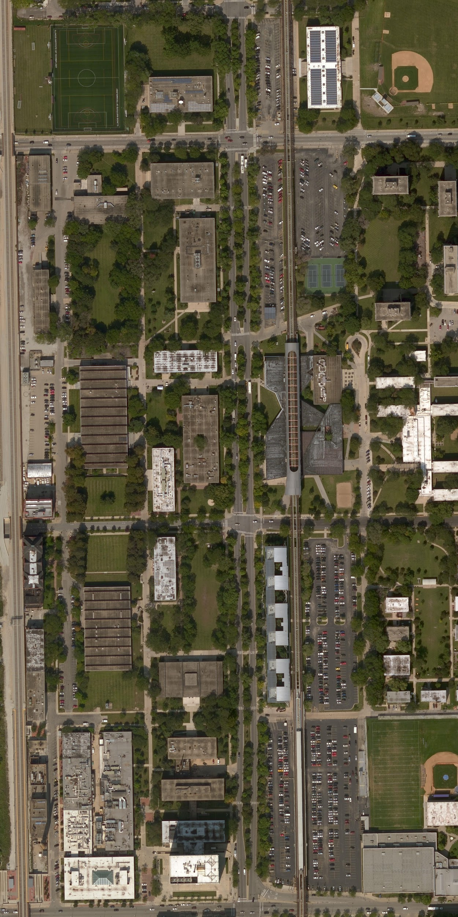
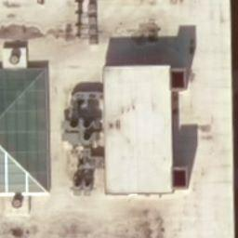
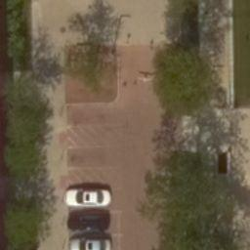
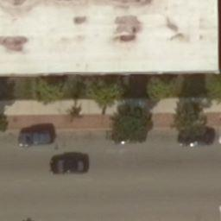
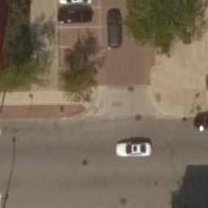
Aerial View of IIT
We used latitude, longitude while Bing maps uses longitude, latitude - (x,y) vs (y,x)
We process the map as we process the tile (saves RAM)
Tiles ordered using relative tile position on map
File names are written : “<X>-<Y>.jpeg”

Slide 5
IIT Map Details
Example: IIT Bounding Box
-87.629563, 41.831082
-87.623598, 41.839606
Each tile is 256x256 pixels
Map Resolution: 4352x8074 pixels
Level of detail - 20

Slide 6
Future Improvements
Python’s PIL has a memory allocation limit
Too many tiles == doesn’t work
Our limit: 2¹³x2¹³ or 8192x8192 pixels
Threaded Performance:
Good for High Level of detail
Requires lots of memory
Increase detail-level from 19 or 20
You currently have to know the detail-level of your bounding box

